Slide 1
HUMAN AXIS CLASSIFIER
Human Brain Axis Classifier
Atlas-trained orientation prediction for human brain slices
01

Slide 2
DESIGN CHOICE
Trained entirely on a single synthetic atlas
No patient images were used during training. Every training example comes from one MNI152 reference brain, sliced and augmented — yet the model is evaluated on real, unseen patient scans.
1
2
3
MNI152 atlas volume
→
Evenly-spaced slicing
→
8× deterministic augmentation
Single T1w reference brain (193 × 229 × 193), oriented to RAS and split into coronal / axial / sagittal dimensions.
90 slices sampled per axis (270 total), skipping the outer 5% on each side to avoid empty edge slices.
Each slice rotated (0°/90°/180°/270°) and mirrored — 270 slices become 2,160 training images.
Why it matters: removes any dependency on labelled patient data for training — the model generalises from one anatomical reference to real-world scan orientation.
02

Slide 3
ARCHITECTURE
Model & training configuration
Input
Backbone
Head
Output
320×320 RGB
(grayscale → 3-channel)
→
ConvNeXt-Tiny
ImageNet-pretrained
→
Dropout(0.4) → Linear(128)
→ GELU → Dropout(0.2) → Linear(3)
→
Softmax → 3-class
Coronal / Sagittal / Axial
Training strategy
Optimiser
Loss
Training data
Head-only for 4 epochs, then unfreeze top 50% of the backbone at epoch 5.
AdamW · lr 5e-4 → 1e-5 on unfreeze
ReduceLROnPlateau (patience 3)
CrossEntropyLoss (3-class)
Gradient clipping, max norm 1.0
Atlas slices only — no real patient images. 8× rotation/flip augmentation, no real-world transforms.
03

Slide 4
DESIGN CHOICE
Eight-variant deterministic augmentation
Every atlas slice is expanded into 8 fixed variants — 4 rotations × mirrored / not mirrored — rather than randomly sampled transforms. No flips are applied at inference; orientation is axis-sensitive.
270
atlas slices
(90 per axis)
0°
0° mirrored
90°
90° mirrored
2,160
training images
after augmentation
180°
180° mirrored
270°
270° mirrored
04

Slide 5
RESULTS
Test-set evaluation
285 real patient images · zero overlap with atlas training data
96.49%
275 / 285
0.9940
1.0000
0.0365
Overall accuracy
Correct predictions
Mean confidence
Median confidence
Confidence std. dev
Per-class precision & recall
Confusion matrix (rows = true, cols = predicted)
Class | Recall | Precision
Coronal | 1.0000 | 0.9000
Sagittal | 0.9899 | 1.0000
Axial | 0.9062 | 1.0000
 | Cor | Sag | Axi
Cor | 90 | 0 | 0
Sag | 1 | 98 | 0
Axi | 9 | 0 | 87
05

Slide 6
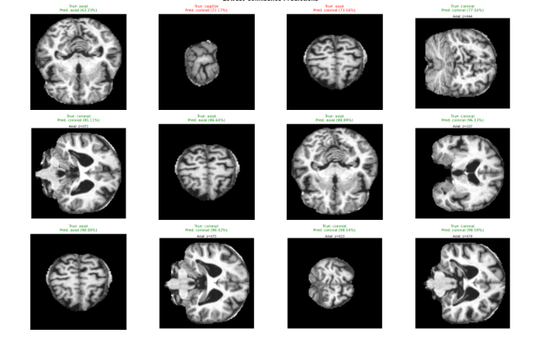
RESULTS
Sample predictions
Prediction grid — true / predicted class and confidence for representative test slices
06

